Slide 1

Predicting Customer Churn with Machine Learning
An Internship Project Presentation
Presented by: Mansi Das
This project explores how machine learning models can identify at-risk customers before they leave, enabling targeted retention strategies that reduce business costs.

Slide 2

The Business Challenge
Why Customer Churn Matters
Customer churn — when customers stop using a service — represents a significant cost for businesses. Acquiring new customers is typically 5-25 times more expensive than retaining existing ones.
Project Objective
Build and evaluate machine learning models to accurately predict which customers are likely to churn, enabling proactive intervention.
Dataset Overview
The WA_Fn-UseC_-Telco-Customer-Churn dataset contains 7,043 customer records with 20 features capturing demographics, services, and billing information.

Slide 3


Data Preprocessing & Feature Engineering
Data Cleaning
Feature Encoding
Converted TotalCharges to numeric format and filled missing values using the median to preserve data integrity whilst avoiding skew from outliers.
Mapped binary categorical features (gender, Partner, Dependents) to 0/1 and applied One-Hot Encoding to multi-class features like InternetService and PaymentMethod.
Target Variable
Transformed the Churn column from "Yes"/"No" text labels to binary values (1/0) for model compatibility.

Slide 4
Methodology: Preparing for Model Training
01
02
03
Feature Scaling
Strategic Data Splitting
Handling Class Imbalance
Applied StandardScaler to normalise all features, ensuring optimal performance for distance-based algorithms like Logistic Regression and neural networks.
Divided the dataset into 80% training and 20% testing sets, using stratified sampling to maintain the proportion of churned versus non-churned customers in both sets.
Stratification was crucial given the imbalanced nature of churn data, where typically fewer customers churn than remain active.

Slide 5

Model Experimentation
To identify the most effective approach, we trained and compared four distinct classification algorithms, each with unique strengths.
Logistic Regression
1
A reliable baseline model for binary classification, offering interpretability and solid performance on linearly separable data.
Random Forest Classifier
2
An ensemble method combining multiple decision trees, known for robustness and ability to handle complex, non-linear relationships.
XGBoost Classifier
3
A powerful gradient-boosting algorithm that builds models sequentially, each correcting the errors of its predecessors.
Artificial Neural Network
4
A deep learning model built with TensorFlow/Keras, featuring Dense layers, Dropout regularisation, and EarlyStopping to prevent overfitting.

Slide 6
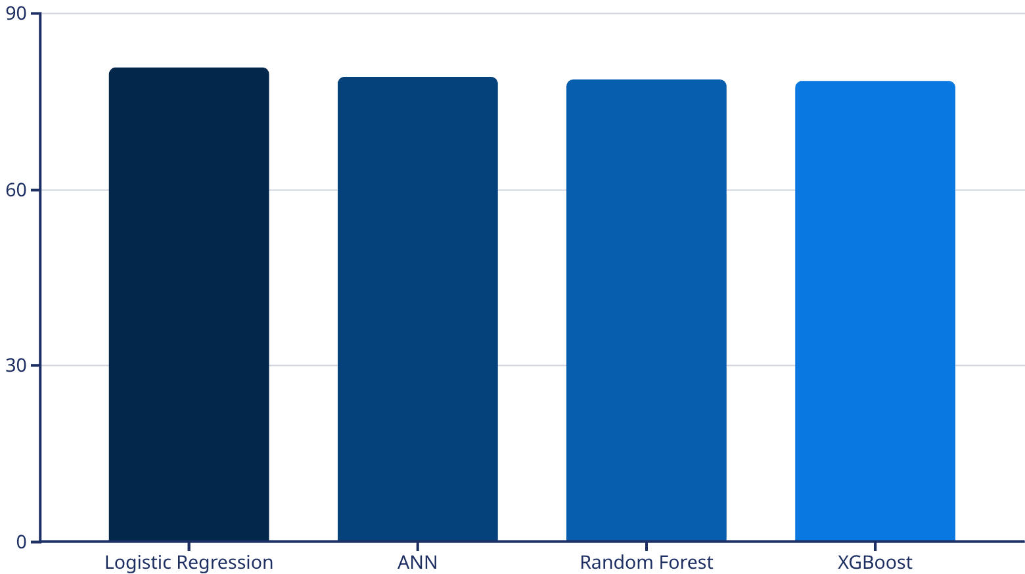
Results & Model Comparison
Performance Metrics
Key Insights
We evaluated models using accuracy and classification reports (Precision, Recall, F1-Score) for both classes to understand performance on churned and retained customers.
Logistic Regression achieved the highest overall accuracy at 80.7%, though all models performed consistently in the 78-81% range.
The F1-score for the minority class (Churn=1) was lower across all models, highlighting the inherent challenge in predicting customers who will leave.
This similarity suggests the dataset's features provide comparable predictive power across different algorithmic approaches.

Slide 7


Deployment & Conclusion
Final Model Selection
The Random Forest Classifier was chosen for deployment due to its robust performance and excellent generalisation capabilities.
Deployment Package
Created a single .pkl file using joblib containing the trained model, StandardScaler, and feature columns — ready for production use.
Project Outcomes
Successfully built and compared four machine learning models, creating a deployable asset (final_churn_model.pkl) capable of predicting customer churn with approximately 79% accuracy. This tool empowers businesses to identify at-risk customers and implement targeted retention strategies, ultimately reducing churn costs.
Next Steps: Integration with CRM systems, A/B testing of retention campaigns, and continuous model refinement based on new data.

